Slide 1

Rosemount 5900S Radar Level Gauge

Slide 2
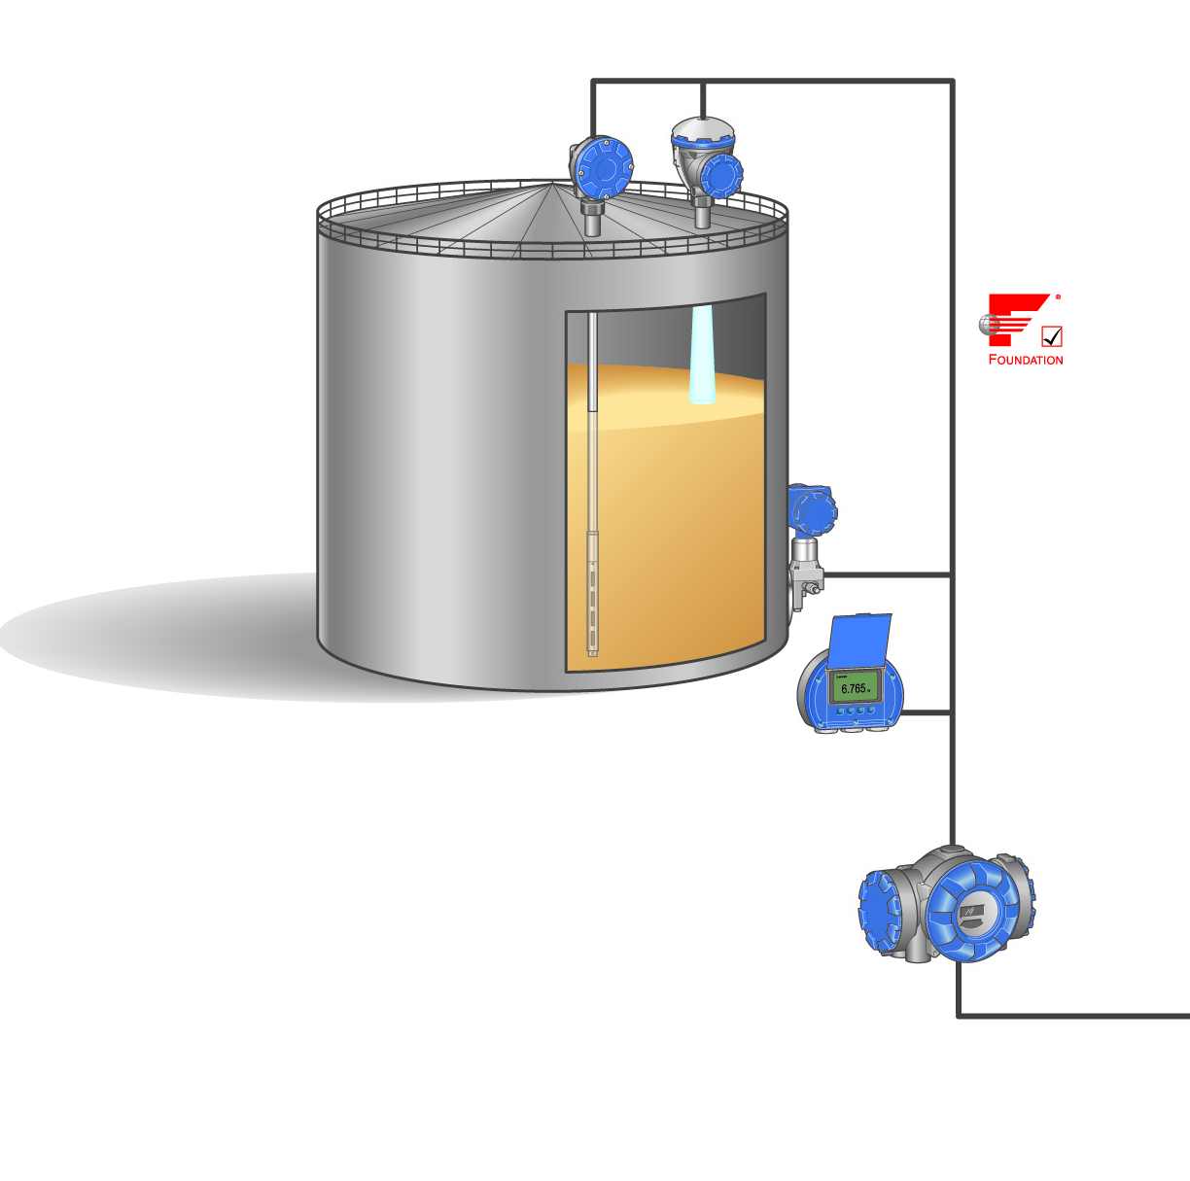
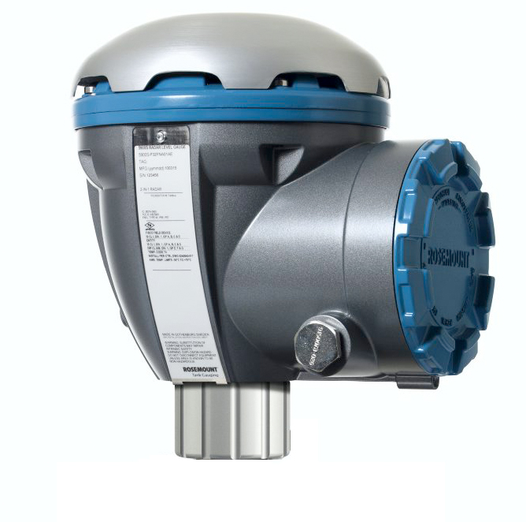
5900S Radar Level Gauge
4th Generation of land based Tank Gauging
Re-use of radar and Tank gauging know-how
10 GHz FMCW Technology
Re-use existing Rex antennas (developed and improved over the last 20+years)
Drip-off design
Low-loss mode in pipes
Signal Processing optimized for hi-accuracy TG
New and unique patented 2-in-1 solution
2-wire Tankbus for power and communication
Intrinsically safe / FISCO
SIL 2 and SIL 3 with IEC 61508 certification

Slide 3
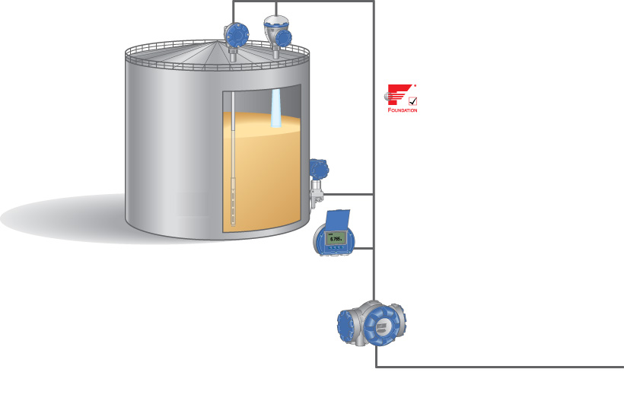
Raptor System Configuration
2240S Multi input Temperature Transmitter
5900S Radar Level Gauge
Tankbus: FOUNDATIONTM fieldbus
3051S Pressure Transmitter
2230 Graphical Field Display
2410 Tank Hub
Fieldbus

Slide 4
5900S Specifications
Instrument accuracy
±0.5 mm (0.020 in.)
Temperature stability in temp range -40 to +70 °C (-40 to +158 °F)
Less than ±0.5 mm (0.020 in)
Repeatability
0.2 mm (0.008 in)
Update time (measuring rate)
New measurement every 0.3 s
Notes:
Update rate 3Hz, i.e. 3-4 measurements per sec.
Tank hub collects data from 5900S 1 time/sec

Slide 5
5900S Installation Considerations
Intrinsically Safe
Powered over the Tankbus from 2410
Requires 50/100 mA (single/2-in-1)
Daisy-chain possibility
Built-in termination jumper
To be connected if required
Easy configuration in TankMaster

Slide 6
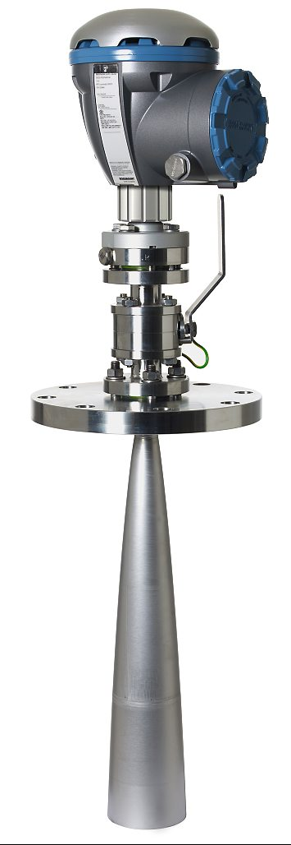
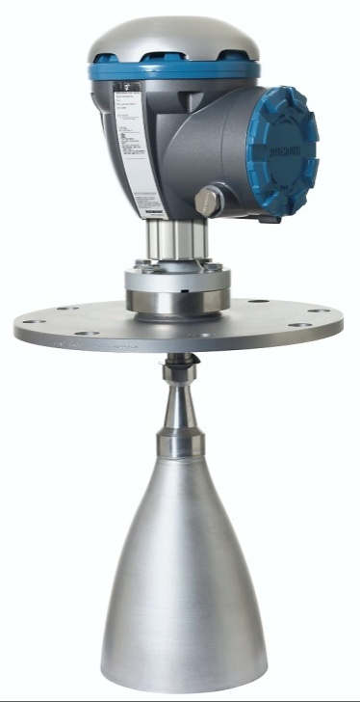
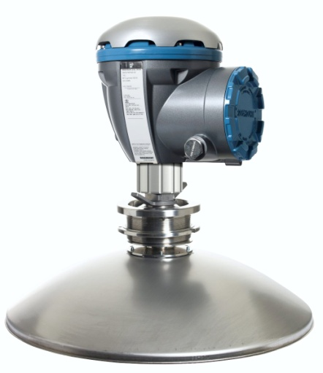
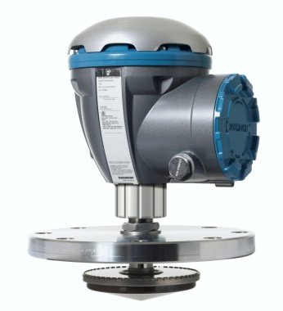
5900S Antennas
5900S Still-pipe Array Antenna
5900S Parabolic Antenna
5900S Horn Antenna
5900S LPG/LNG Antenna
Notes:
Note! New names; no more x920, x930 etc.
Possible to mix antennas and heads however you wish.
Now there is one label for each antenna, antenna is no longer specified on gauge-label.

Slide 7
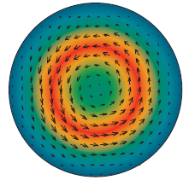
5900S Still-pipe Array Antenna
Designed for:
5”, 6”, 8”, 10” and 12” still-pipes
Typical applications
Crude oil tanks with floating roofs
Gasoline/product tanks with or without inner floating roofs
Drip-off design
Low loss mode technology

Slide 8
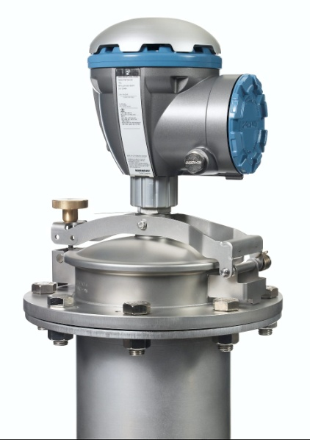
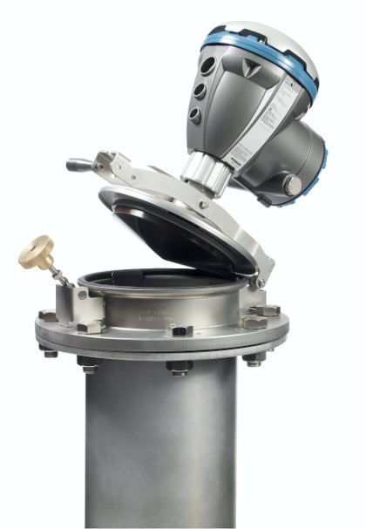
5900S Still-pipe Array Antenna
Fixed version
Hinged hatch version
Enables handdip
Requires flexible cables/conduits
Notes:
The lock on the hinged hatch version is of better design than before.
Easier and better for your hands to work with.

Slide 9
5900S Still-pipe Array Antenna
Measuring range
0.8 to 30 m (2.6 to 100 ft) below flange
0.5 to >40 m (1.6 to >130 ft), possible.
Pressure range
Fixed version: -0.2 to 2 bar (-2.9 to 29 psig)
Hatched version: 5” to 8” pipes, -0.2 to 0.5 bar (-2.9 to 7.2 psig). 10” and 12” pipes, -0.2 to 0.25 bar (-2.9 to 3.6 psig)
Retrofit
OK for Rex 3950/Pro Array manufactured year 2010 or later
Notes:
Older antenna than 2010 may not be used. Oscillations will then be visible.

Slide 10
5900S Parabolic Antenna
Designed for
Fixed roof tanks
Works on floating roofs too
18-inch manways or larger
Custody transfer accuracy
Measures on all types of liquids
Bitumen and Asphalt
Sticky and condensing products
Retrofit
Easy plug-in installation on Rex 3930 or Pro parabolic antennas possible
Notes:
No retrofit for TRL/TRL2 parabolic antennas.

Slide 11
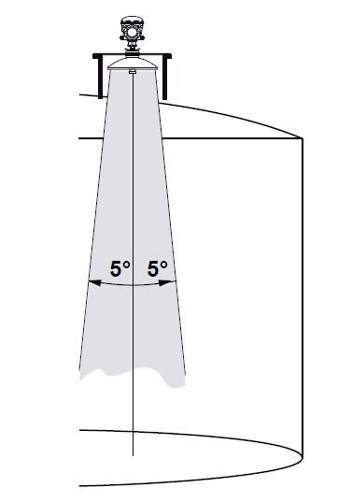
5900S Parabolic Antenna
Measuring range
0.8 to 30 m (2.6 to 100 ft) OIML range
0.5 to 50 (1.6 to 164 ft), possible.
Pressure range
Clamped -0,2 to 0,2 bar (-2,9 to 2,9 psig)
Welded -0,2 to 10 bar (-2,9 to 145 psig)
Narrow beam
Suitable in narrow tanks with internal structures
THE BEST ANTENNA FOR FREE PROPAGATION

Slide 12

5900S Horn Antenna
Designed for
8 -17 inch nozzles
Fixed roof tanks
Works on a variety of oil products and chemicals
Flange
Horizontal flange
4° inclined flange
Plug-in installation on Rex 3920 antenna possible
Requires 5900S adapter
New Adapter
Notes:
New adapter for Raptor (if changing from Rex to Raptor using the same antenna)

Slide 13

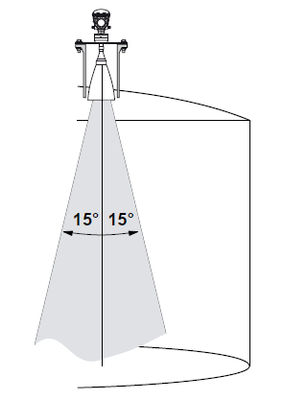
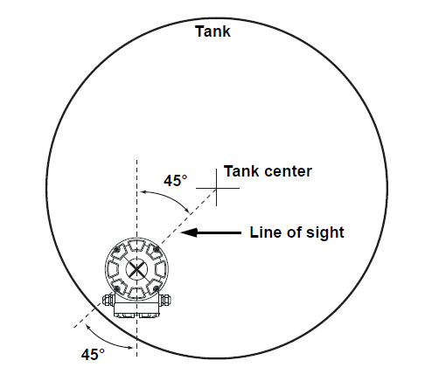
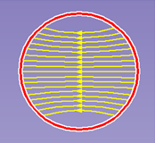
5900S Horn Antenna
Measuring range
0.8 to 20 m (2.6 to 65 ft) standard
0.5 to 30 m (1.6 to >100 ft) possible.
Pressure range
-0.2 to 2 bar (-2.9 to 29 psig)
Installation
Linear polarization for 2-in-1 technique
15° beam angle
Requirements for orientation on tank
Notes:
2-in-1 requires linear polarization.
Installation considerations: A 45° hit of radar waves agains the tank wall is the optimum installation to avoid disturbing echoes from wall.

Slide 14
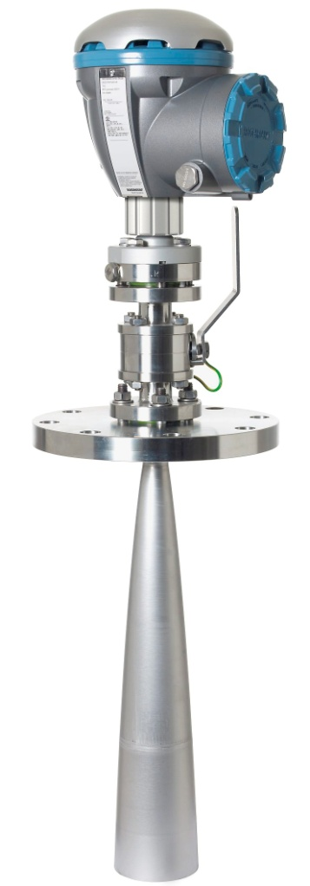
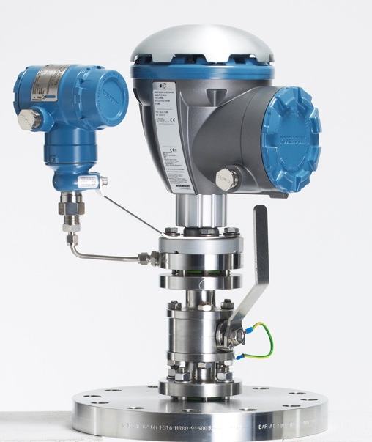
5900S LPG/LNG
Designed for
Liquefied gas in LPG/LNG tanks
4” still-pipes sch 10 or 40
100 mm still-pipes
Quartz/Ceramic window as pressure sealing
Verification pin function
Optional
Ball valve, fire-proof
Rosemount 2051 Pressure sensor
Flange available in six versions
4 in. class 150, class 300
6 in. class 150, class 300
8 in. class 150, class 300
New Adapter
Notes:
New adapter when changing from Rex to Raptor.
Two different LPG & LNG:
LPG: ball valve & pressure sensor
LNG: ball valve only

Slide 15
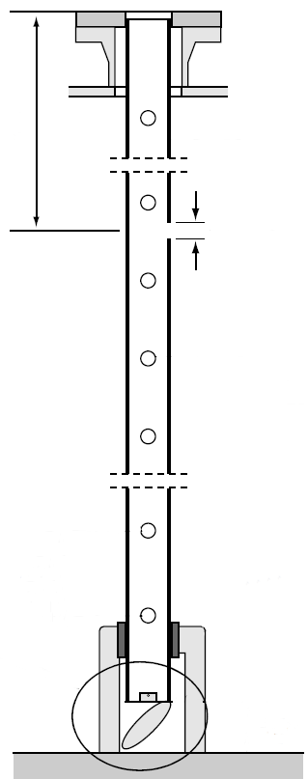
5900S LPG/LNG
On line verification
Auto/manual configuration
Still-pipe requirement changed
Verification pin oriented 90° from line of equalization holes
Pin length = ½ pipe diameter
Pin position above max product level
Pin position 1.0 to 2.5 meter below flange
Deflection plate
verification ring at pipe end
Retrofit
Yes, possible to install on Rex 3960 antennas (with still-pipe according to Rex spec)
Requires change of pressure sensor
Verification on tank possible
Requires manual rotation of 5900S transmitter head.
1000 - 2500 mm
Hole for verification pin
> 200 mm
Max product level
Notes:
NOTE: Verification pin oriented 90° from line of equalization holes (this is different from REX!= new pipe req. )
Note! New installation drawings for LPG/LNG tanks: extra hole for verification pin.
Verification pin must be above the surface.
Pin length should be about 50% of the pipe diameter.
Same plate as before.

Slide 16
Hardware - Overview
Weather protection
Cover (held by 4 screws)
Junction box cover
Label
Cable entrance 2 x ½ in NPT
Waveguide nut

Slide 17
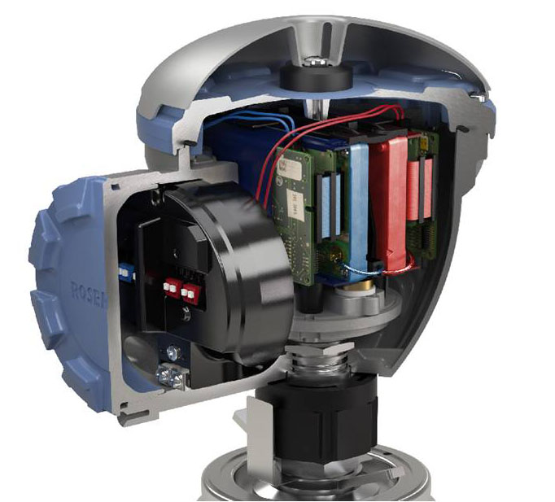
Hardware - Interior
The transmitter head electronics (THE) includes
One or two radar level modules
Microwave port
Mounting frame.
The Radar module Includes:
Microwave module
RM (Radar Module)
PM (Processor Module)
CM (Communication Module)
Electronics is potted in plastic frames
Assembled together
Notes:
Microwave module and RM assembled together.

Slide 18
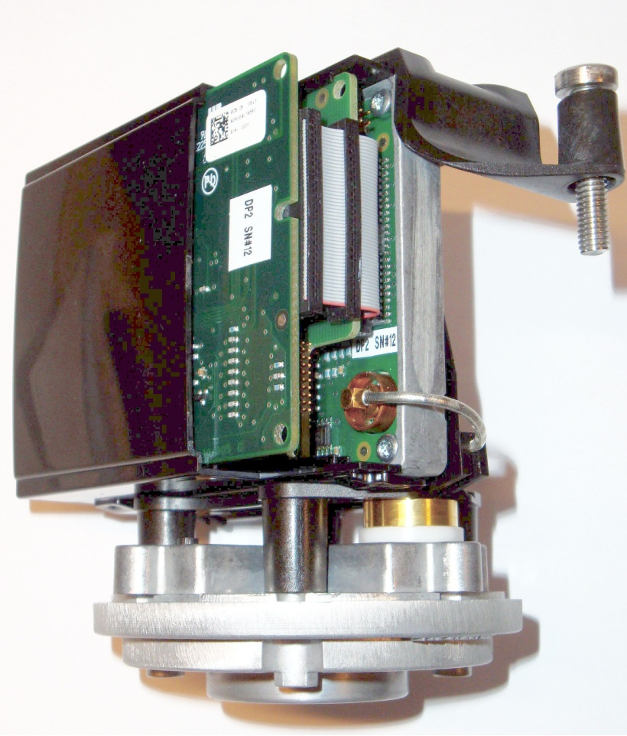
Hardware – Single THE overview
RM (Radar Module, (includes Microwave module)
PM (Processor Module)
CM (Communication Module)
Microwave coax connector (connects RM and MW turnstile)
Microwave turnstile (mechanical connection to antenna)
CM
PM
RM
Coax
MW Turnstile
µ~
Notes:
RM= contains microwave module and a control board
PM= Processor module contains hw and sw to control the RLG function
CM= handles communication(Tank Bus)
Coax connector= interconnects the RM and microwave turnstile(=vändkors) to be able to transmit energy to antenna
MW turnstile= is a mechanical waveguide ‘junction’ guiding the MW energy from one or two modules (EM’s) to the antenna and back.

Slide 19
Hardware - RLG
RLG block diagram
Shows the internal connection of boards
Connection of power&bus and MW connection to antenna
Notes:
SIL handled separately. Totally controled by the RM-software.

Slide 20
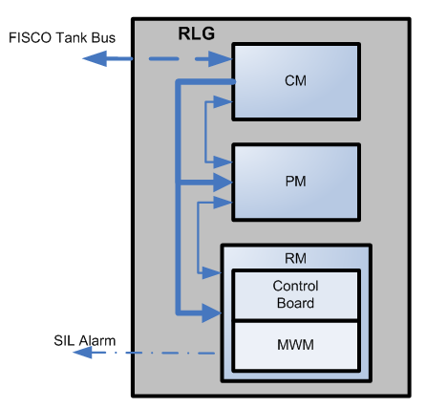
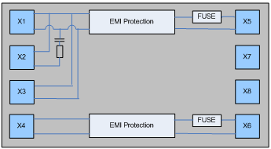
Hardware - RLG - 2-in-1
Terminal block 2-in-1
TankBus
TankBus
Notes:
The fuses are not replaceable.
The dotted line shows 100% separation between the primary and secondary device.

Slide 21
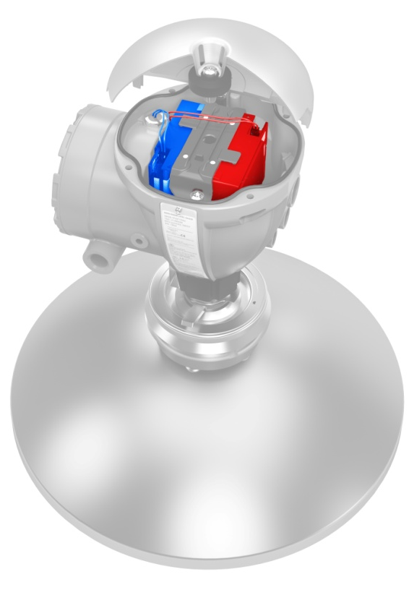
5900S 2-in-1 Radar Level Gauge
Two independent and continuous level measurements on the same tank opening
Unique and patented solution
The same Rosemount 5900S gauge consists of:
Single Antenna
Single Enclosure
Two Separate Electronic Cassettes
Primary and secondary radar level unit
Each one is a complete radar level gauge unit that operates independently of the other
The units are galvanically separated
If one fails the other is unaffected
Primary unit
Secondary
unit

Slide 22
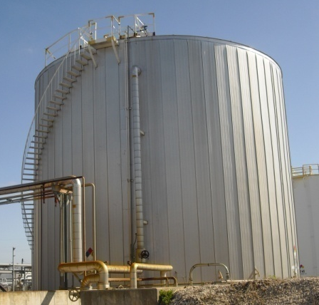
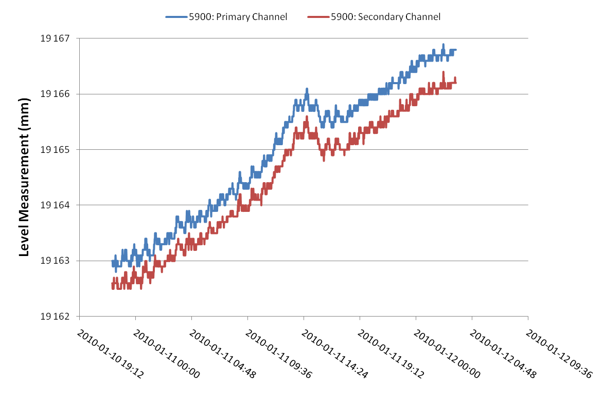
2-in-1 Radar Level Gauge: Measurement Data (example)
RLG#1
RLG#2
Note: An offset between the two RLG’s have intentionally been added for illustrative purposes

Slide 23

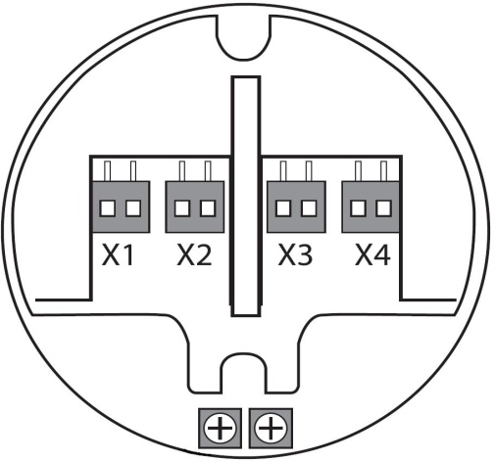
Terminal Block
TB - Terminal block
Power & communication
Overvoltage & EMI protection
IS/FISCO Tankbus
Test connectors for field communictor
Different versions of TB
1-in-1 (standard)
2-in-1
SIL 2
SIL 3
Terminal block
Notes:
Exchangeable spare part.
4 different versions of TB. Always 4 connectors in each TB, used slightly different depending on the version.
Shield should be isolated, absolutely NOT grounded in the fieldbus.

Slide 24
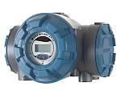
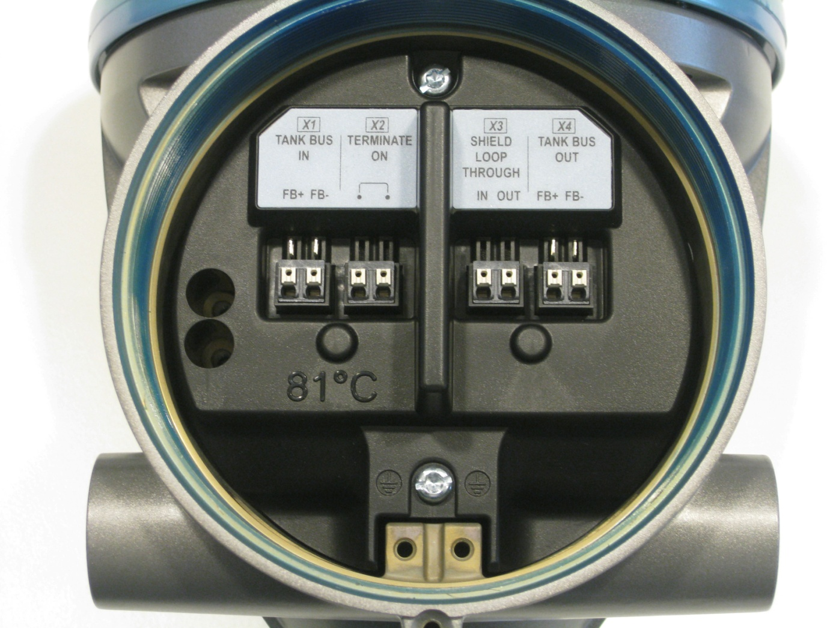
”Standard“ TB with termination

Slide 25
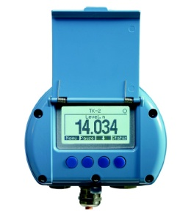
“Standard“ TB with daisy chain

Slide 26
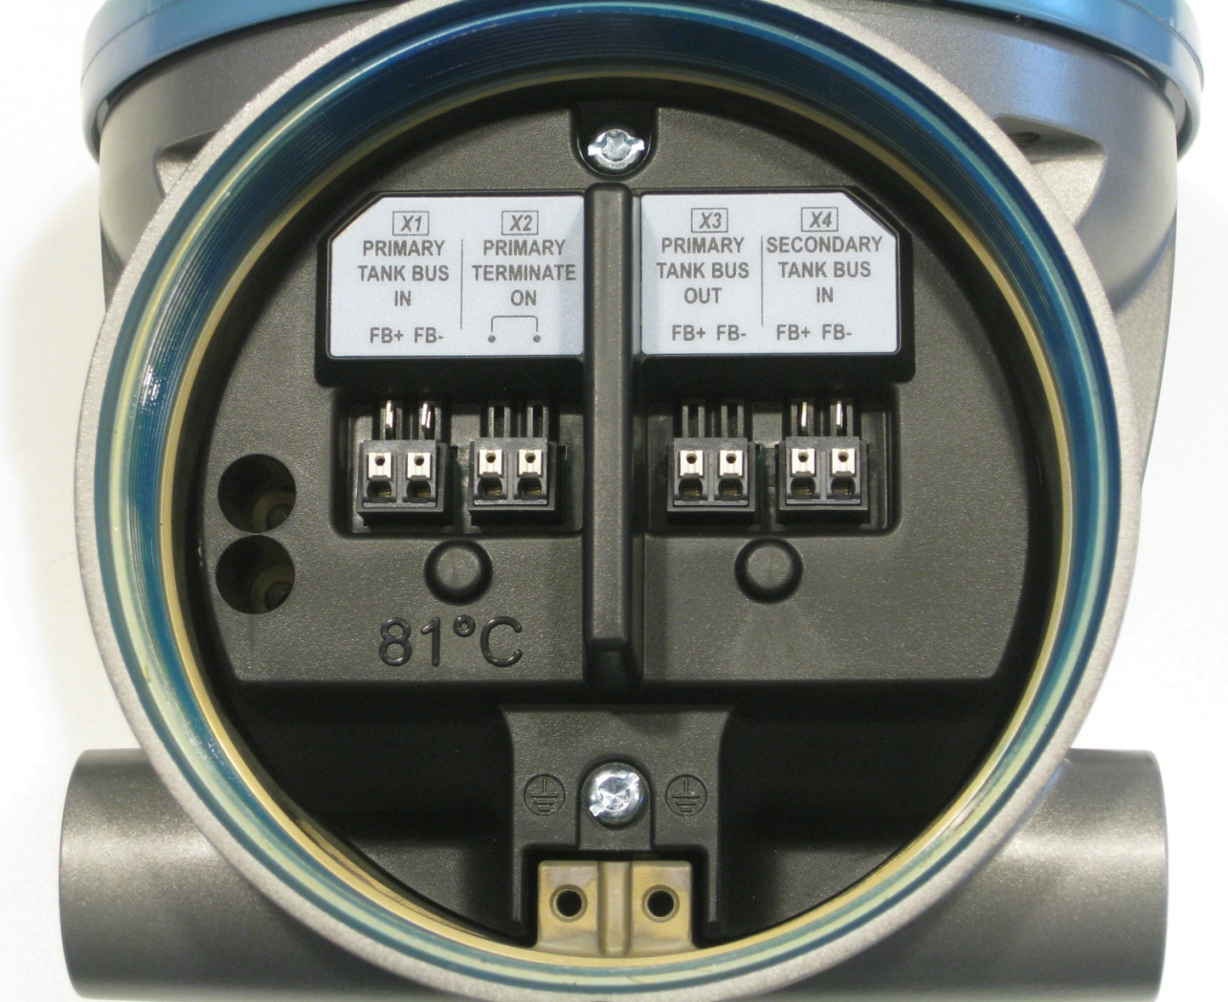
“2-in-1” TB with single tank bus
Tank Bus for the second Radar Module
Isolate cable screen
Terminate
on

Slide 27
”2-in-1“TB with two tank buses
Primary bus Terminate
on

Slide 28
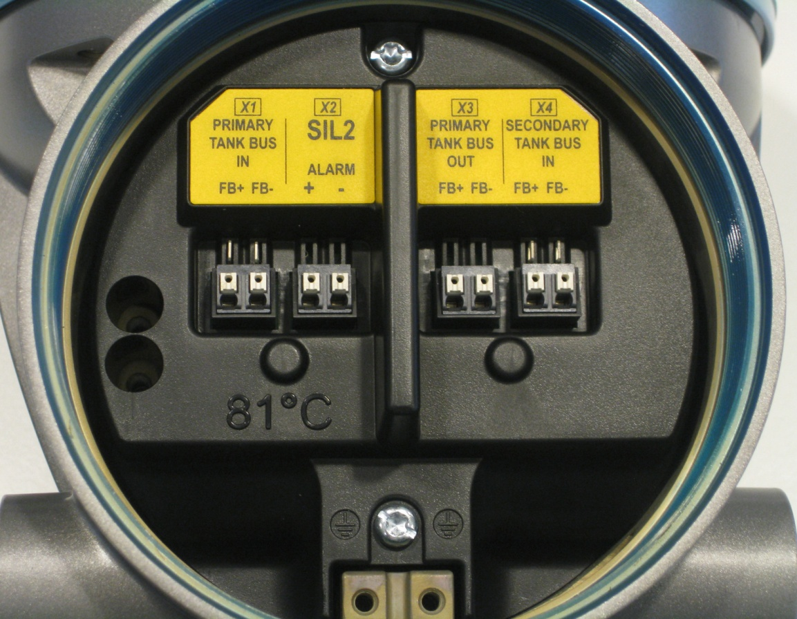

TB “SIL 2” Safety System
SIL
SIL2 configuration
Alarm connected to SIL relay in 2410 hub
Notes:
All SIL installations require two pair of cables between gauge and tankhub:
Communication (tankbus)
SIL Alarm

Slide 29
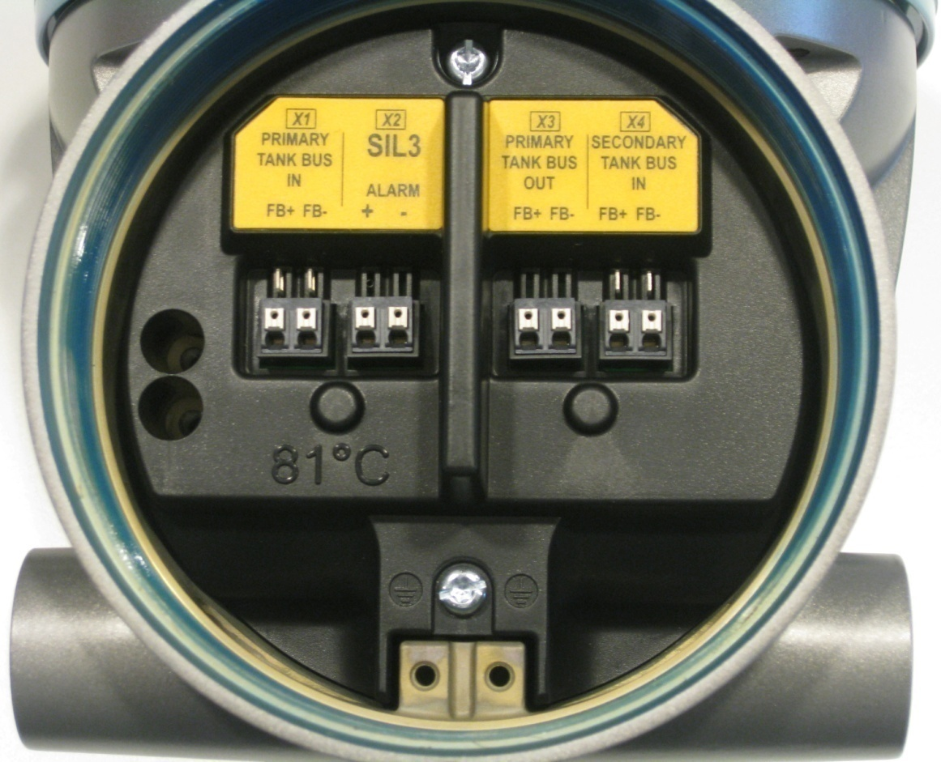

TB “SIL 3” Safety System
SIL3 configuration
Includes 2-in-1 option
Alarm connected to SIL relay in 2410 hub
Jumpers for the second RLG

Slide 30
5900S Software
Based on best functions from Rex/Pro/STaR/5400
Highlights:
Accuracy and filtering (Rex)
Echo tracking and logics (Pro)
Bottom measurement logic (Pro)
Empty tank handling (Pro/5400)
Dynamic parameter settings based on tank geometry/shape (Pro)
Level monitoring (STaR)
SIL (overfill prevention) (New)
Dual memory banks enables reprogramming ”on the fly” under continuous operation (New)

Slide 31
Configuration
Configuration tools
TankMaster WinSetup (recommended)
375/475 Field Communicator
5900 configuration part of the 2410 configuration
Install 2410 using wizard in TM
Finish 2410 installation with ”offline” installation of 5900
Configure 5900 via Properties window
If 5900 is added to existing system, 2410 database must be updated before configuring the 5900

Slide 32
Basic Configuration
Measurement Units
Tank Geometry
Tank height, tank type, tank bottom type, pipe diameter, hold off distance, calibration distance etc
Process Conditions
Rapid level changes, turbulence, foam, solids & product dielectric range
Volume
Standard tank types & strapping table

Slide 33
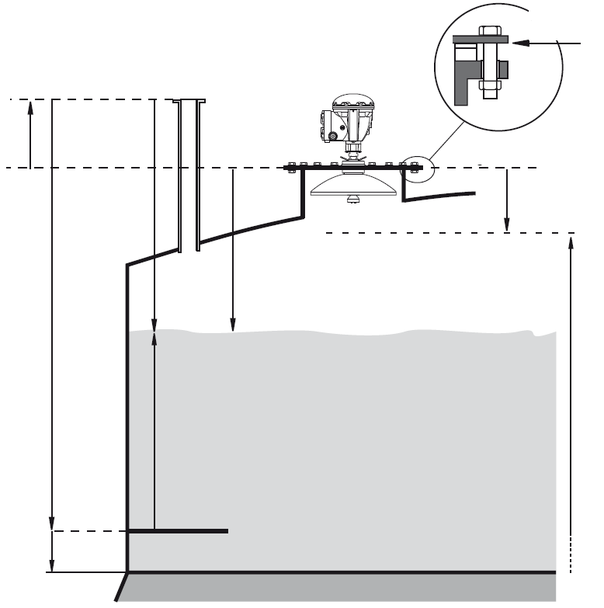
Basic Configuration
Gauge Ref. Point
Tank Ref. Point
Gauge Ref. Distance (G)
Hold Off Distance
Tank Ullage
Ullage
Tank Ref. Height (R)
Measuring Range
Level
Zero Level (Dipping Datum Point)
Min. Level Offset (C)
Notes:
Parameters used for tank geometry configuration of a 5900.

Slide 34
Advanced Configuration
Available for optimizing performance in advanced applications, such as
Disturbing objects in tank
Turbulent conditions
Unusual tank shape
Available advanced functions:
Tank Scan
Empty tank handling
Surface echo tracking
Filter settings

Slide 35
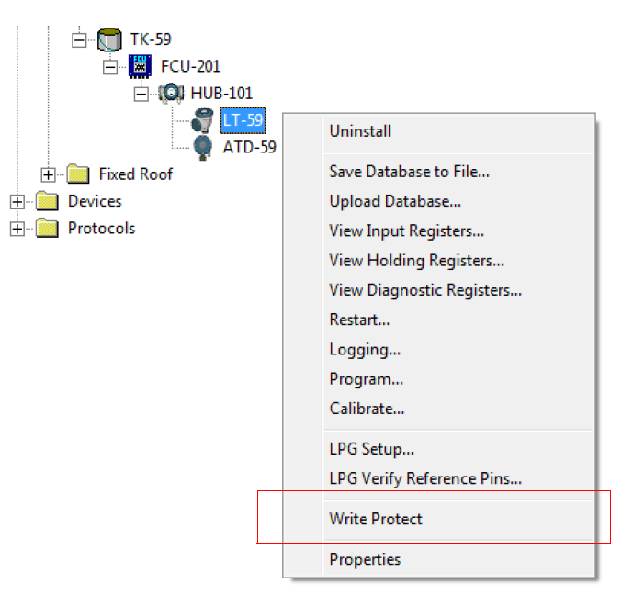
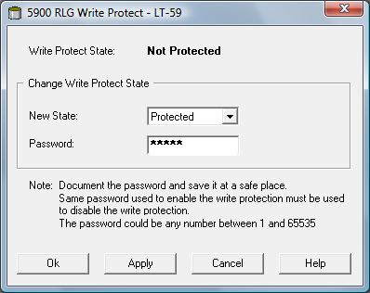
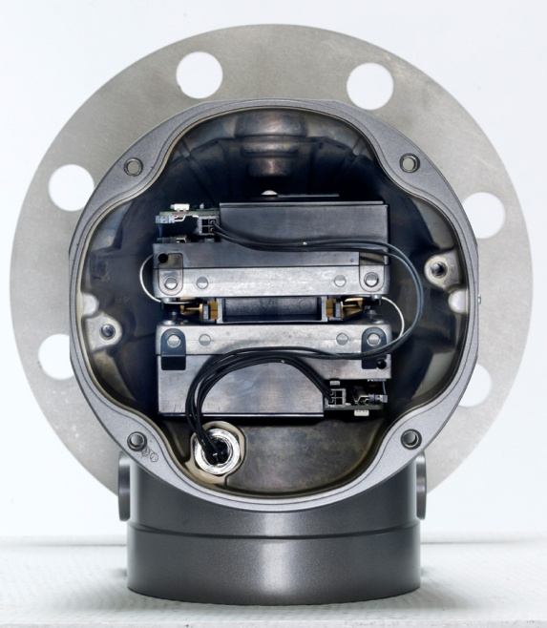
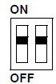
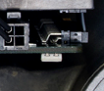
Write Protection
To avoid accidental changes of configuration
TankMaster WinSetup
Hardware switch

Slide 36
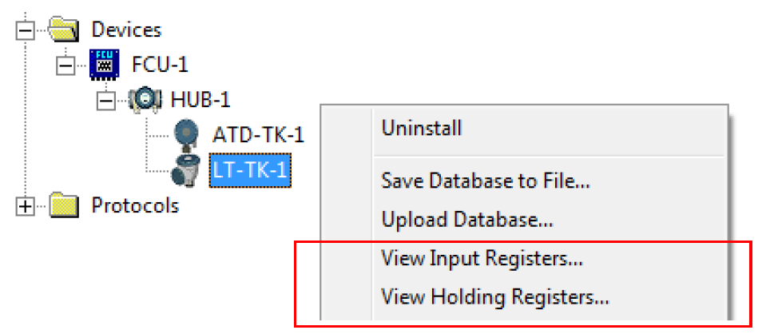
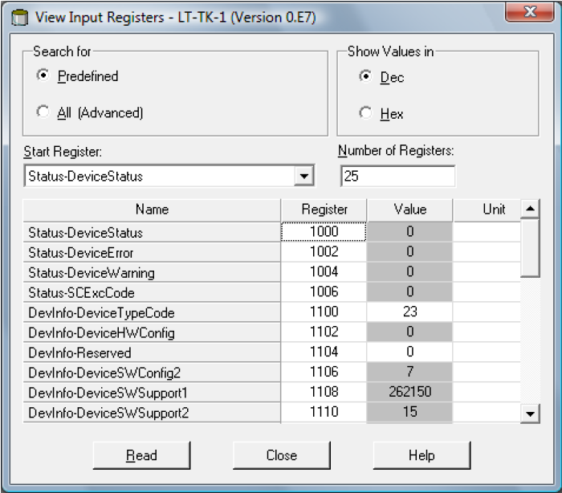
Holding & Input Reg
Holding Register
Stores various parameters, configuration data
Edit by typing in new value or change separate bits
Input Register
Stores transmitter data

Slide 37
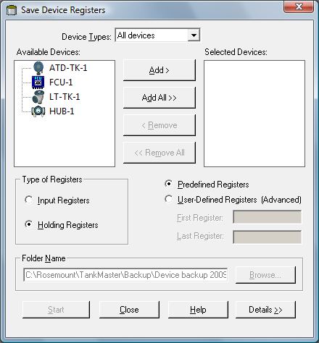
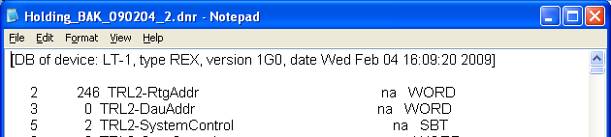
Backup copy of several devices
Right click on devices folder
Save Database of All to Files...
Holding Registers and Predefined
Add specific devices or Add All
Choose Holding Registers and Predefined Registers options
Browse and select the folder where to save the files
Click Start button
Backup file can be viewed as a text file in i.e. Notepad

Slide 38
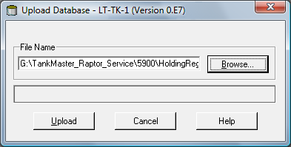
Recover a Backup Config Database
Select the device in the Workspace for which you want to load the new database
Click the right mouse button and choose the Devices/Upload Database option
Click the Browse button and choose the database file to be uploaded
Click the Upload button

Slide 39
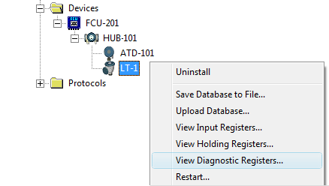
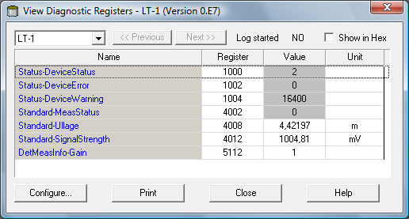
Diagnostics
Pre-defined selection of database registers for an instant view of the device status
Read only
Loaded from the device as the window is opened
Grey background if more information (Bitfield or ENUM)
Hexadecimal possible
Configure button
Change the list of registers to be displayed
Possible to log registers

Slide 40
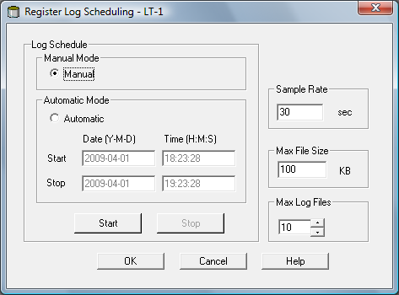
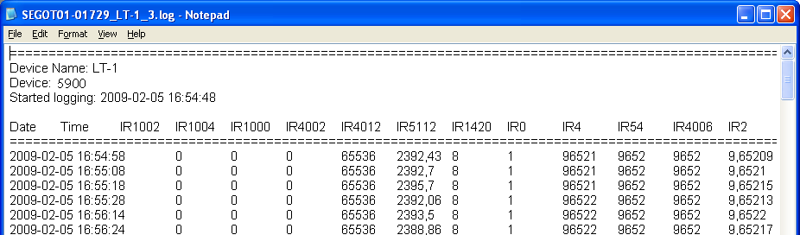
Logging Diagnostics
To verify that gauge works properly
Manual mode
Start logging at any time
Automatic mode
Specify Start and Stop time
Log file stored as plain text file
Saved in ...\Rosemount\TankMaster\Setup\Log folder

Slide 41
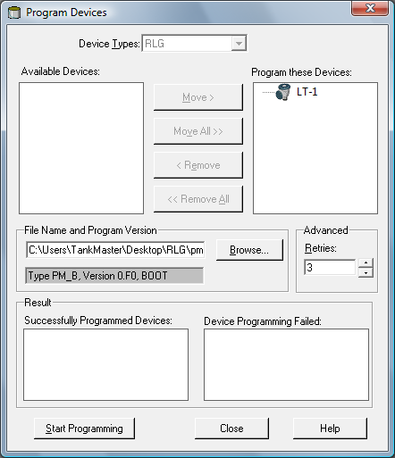
Upgrade Gauge Software
Ensure stable connection between gauge and TM
Rightclick on the device and select Program option (Program All for multiple devices)
Click Brows to locate the flash program file (file extension *.cry)
Click Start Programming button

Slide 42
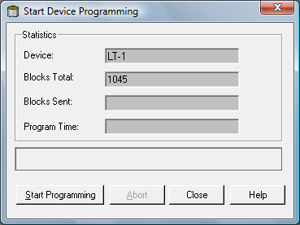
Upgrade Gauge Software
Click the Start Programming button to activate device programming
Update the TankMaster installation by adding the new *.ini files for the 5900 gauge to the TankMaster installation folder
RLG.ini into the ..\Rosemount \Server folder
RLG0xx.ini into the ..\Rosemount\Shared folder
Notes:
If a 2160 Field Communication Unit (FCU) is used, a maximum of 25
devices can be programmed. If there are more devices the programming
must be divided in two steps. Update the TankMaster installation by adding the new *.ini files for the 5900 gauge to the TankMaster installation folder.
For the 5900 two *.ini files are used, RLG.ini and RLG0xx.ini, where xx is
the identification code of the 5900 gauge application software.
The RLG.ini file is copied to the C:\Program Files\Rosemount\Server
folder.
The RLG0xx.ini file is copied to the C:\Program Files\Rosemount\Shared
folder.

Slide 43
Calibrate Function
Why?
To minimize the offset between actual (handdipped) product level and measure level
To optimize measurement performance over the whole measurement range, from top to bottom of tank
How?
TankMaster calculates new Calibration Distance based on a straight line fitted to the deviations between hand dipped levels and levels measured by the transmitter
When?
Specially suitable for still pipe, since minor adjustment of the Scale Factor is often necessary

Slide 44
Calibration Procedure
Record the hand dipped ullage values and the corresponding level gauge values
Enter the hand dipped levels and the level gauge values into TM
Inspect the resulting calibration graph and, if necesarry, exclude measurement points which should not be used in the adjustment calculation
Note! Do not calibrate when
The tank is emptying or filling
Agitators are running
When there are windy conditions
When there is foam on the surface

Slide 45
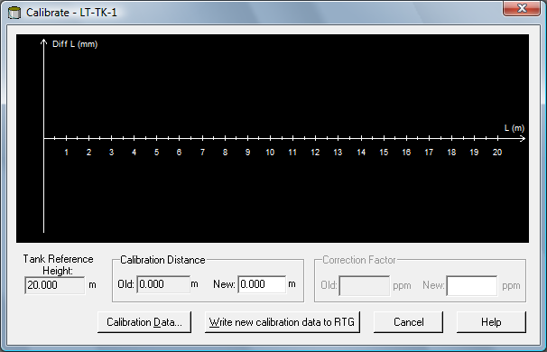
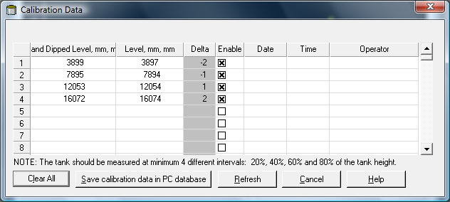
Calibrating the gauge
Right click on the device and choose Calibrate
Make sure Tank Ref Height is correct
If not, adjust in the device Properties window
Click Calibration Data button
Enter the hand dipped level values and the corresponding levels measured by the transmitter.
NOTE! Measurement unit mm is used
Click the Refresh button to calculate the deviations between hand dipped and measured data
Click the Save Calibration Data in PC Database button to save the entered values and return to the Calibrate window

Slide 46

Calibrating the gauge

Slide 47


Calibrating the gauge
Check calibration result
Open Calibration window
All measured values are adjusted according to the calculated Calibration dist and Correction factor
Calibration Data window present the same in numbers

Slide 48

Default Load
View Holding Register
All (advanced)
65510
Read data
Reset to factory settings
Click the Apply button

Slide 49
Possible Troubleshooting
Symptom | Possible cause | Action
No level reading | Communication on the tank bus does not work Data communication cables disconnected Gauge not configured | Check cable connections Check 5900 Modbus comm address Check config of 2410 tank database
Incorrect level reading | Configuration error Disturbing objects in the tank | Check config of tank geometry and antenna paramters (R, G, Calib dist etc) Use Tank scan function to analyze signal...

